Slide 1
Recipe with high traffic
Hossam Ahmed Salah

Slide 2
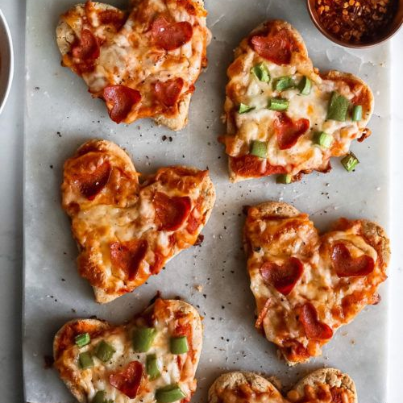
Agenda
Business objective
KPI
Data Validation
EDA
Models and Business metrics
What model satisfy the KPI?
Recommendation for the future

Slide 3

Tasty Bytes
Tasty Bytes was founded in 2020 during the Covid Pandemic.
It started as a recipe search engine to help people utilize limited supplies.
It has evolved into a fully-established business.
Tasty Bytes offers a monthly subscription for a comprehensive meal plan.
The meal plan ensures a healthy and well-balanced diet.
Subscribers can have the ingredients delivered to their doorstep.
Tasty Bytes aims to provide inspiration and support during challenging times.

Slide 4
Business objective

Slide 5
Objectives
Providing inspiration for everyone as Tasty Bytes considered a pioneer in this field.
Increasing the Profit for the company.
By increasing the subscriptions
For more subscriptions we need more traffic
Traffic high when we have popular recipes in the homepage of the site
Traffic to the rest of the website increase 40% in the case of popular recipes
We need to predict recipes that would be popular so lead to high traffic
The accuracy that the business can rely on it can’t be less than 80% most of the time
80% correctly and reliably predict Hight traffic recipes
Recommendation for the business about what features make the recipes popular so they can focus on publishing more of these recipes
Recommendation for any improvement over the business flow and design based on the analysis

Slide 6
Key Performance Indicators

Slide 7
KPI(s)
Increase the traffic 40%
Predict which recipes will be popular 80% of the time

Slide 8
Data Validation

Slide 9
Data Validation
Dataset has 947 rows, 8 columns
Recipe ✅ Numerical id
Calories ❌ Numerical has missing data
Carbohydrates ❌ Numerical has missing data
Sugar ❌ Numerical has missing data
Protein ❌ Numerical has missing data
Category ❌ String type but it 11 categories not 10 has no missing data
Servings ❌ Not Numerical as some values has a text like ‘4 as snack’ no missing data
High-traffic ✅ the missing data represent the recipes with low traffic

Slide 10
Data Validation
Dataset has 947 rows, 8 columns
For missing data we choose to fill it with median for the numerical features
For missing data in the target we fill it with ‘low’ to be other class we have in this problem ‘A Binary Classification’
I did Feature Extraction to extract more insights from the data by making categories out of the numerical data
To prepare the data for the model we should make all the columns numerical this step is the ‘Encoding step’ and later we would scale the data

Slide 11
exploratory data analysis

Slide 12
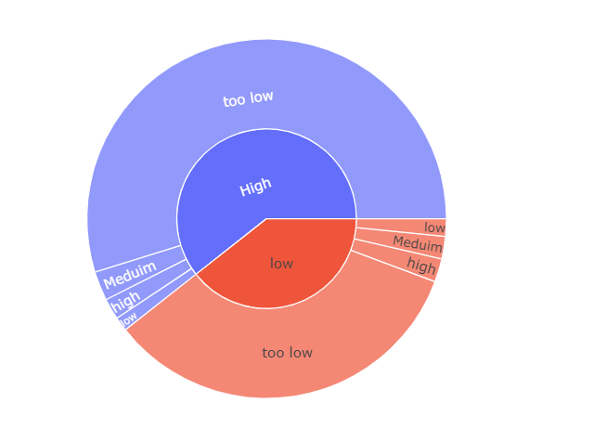
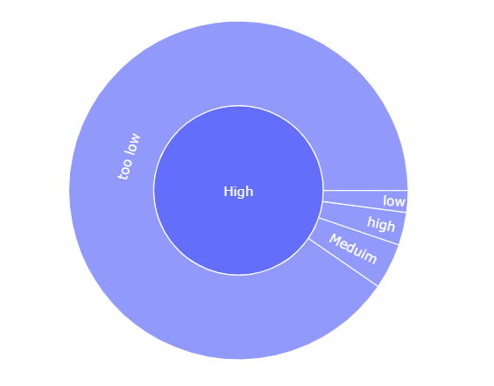
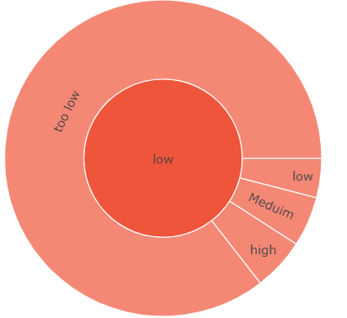
Traffic Vs Sugar categories
519 out of the high traffic recipes are too low sugar levels
Only 18 has high sugar levels
High traffic 574
Low traffic 373
319 out of the low traffic recipes are too low sugar levels
Only 15 has high sugar levels

Slide 13
Traffic Vs Sugar categories
We can notice that the sugar is doesn’t defer to much in the high traffic or low traffic recipes
We would further prove that with other tools
That mean it’s not a strong factor at all
High traffic 574
Low traffic 373

Slide 14
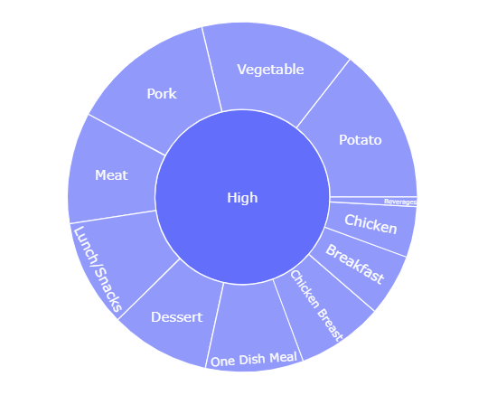
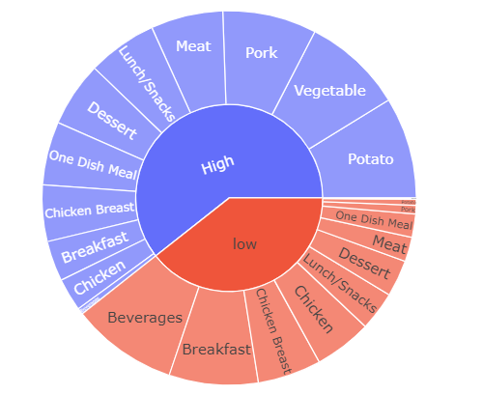
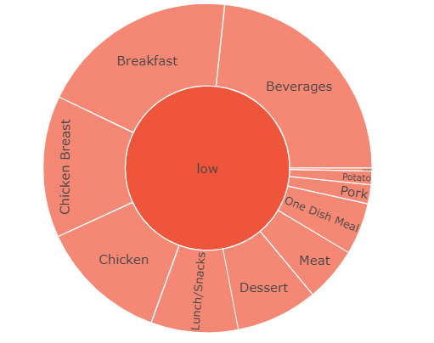
Traffic Vs Category
83 out of the high traffic recipes has the tag Potato
Only 5 has tag Beverages(drinks)
High traffic 574
Low traffic 373
Beverages with 87 recipe of the lowest traffic in the site
Only 5 potato recipes are in the low rank

Slide 15
Traffic Vs Category
We can notice that some categories of food is always high wile other categories is low most of the time
We would further prove that with other tools
That mean that the category feature can be so useful in determine the high traffic recipes
High traffic 574
Low traffic 373

Slide 16
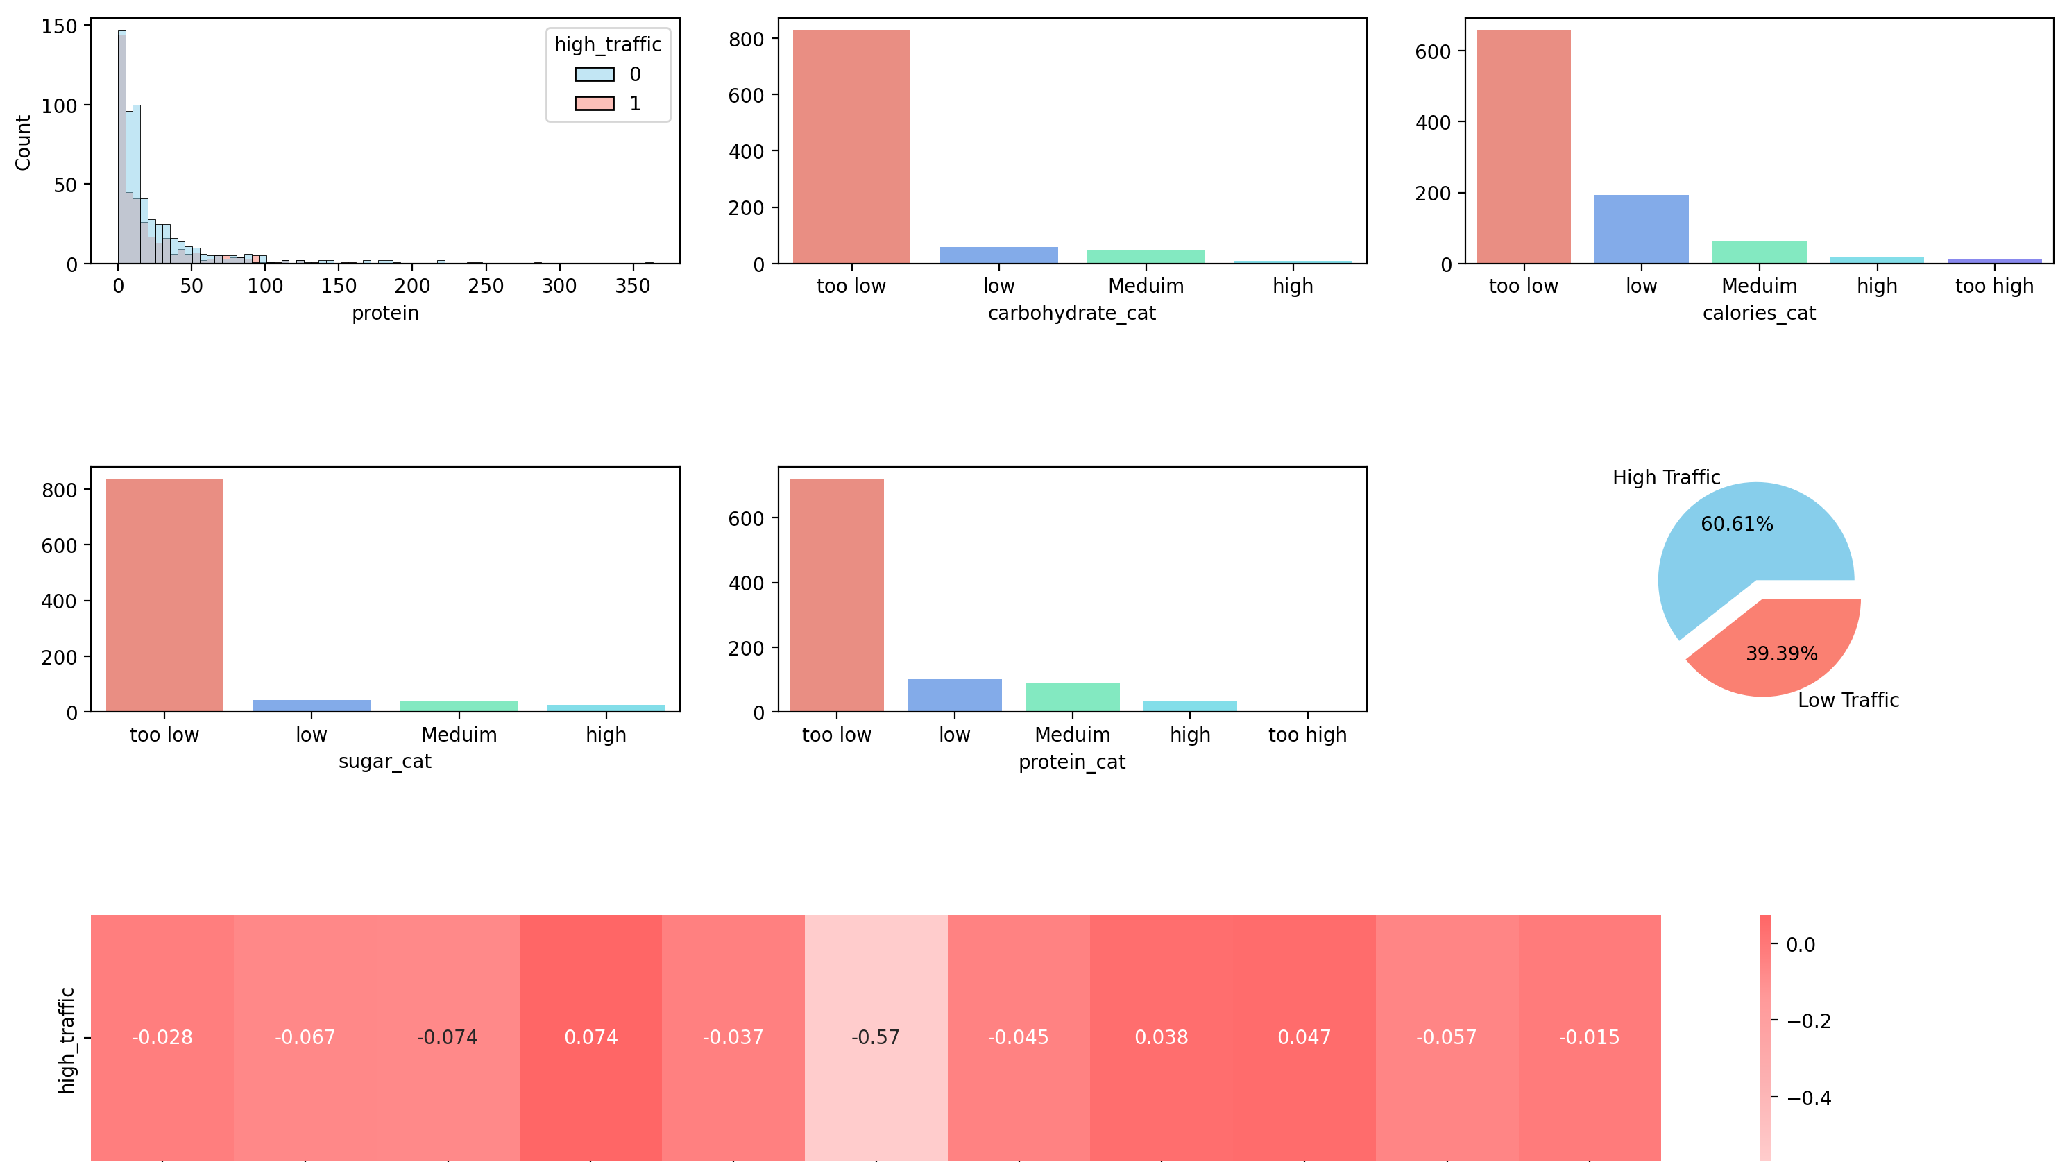

Slide 17
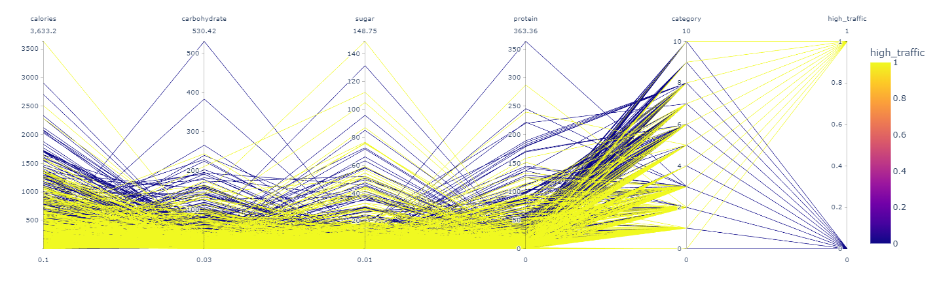
Parallel coordinates plot(PCP)

Slide 18
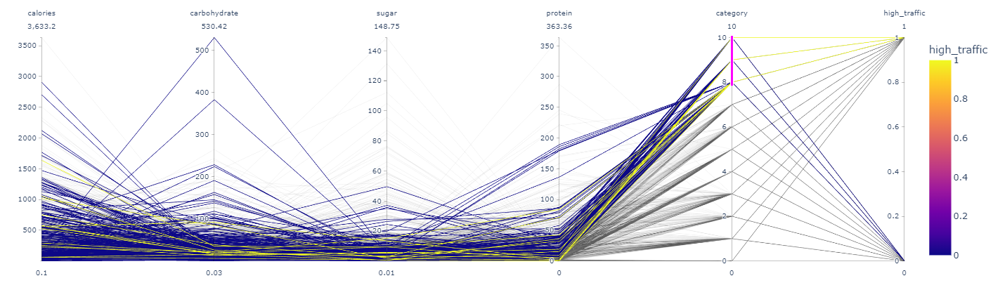
Parallel coordinates plot(PCP)

Slide 19
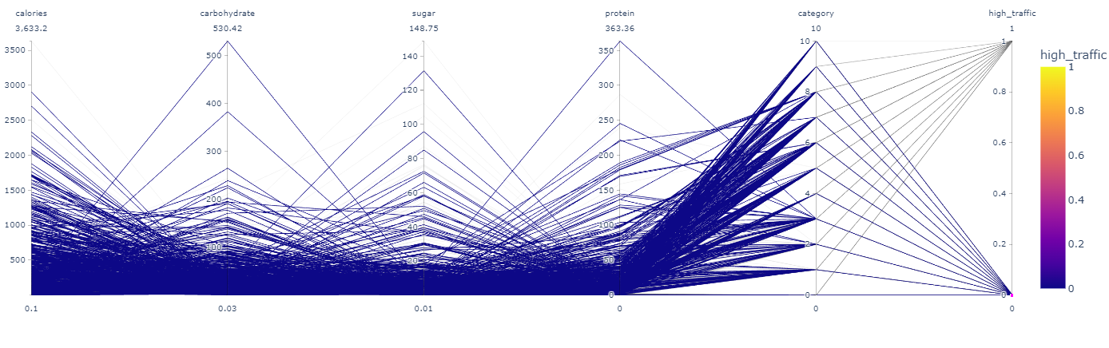
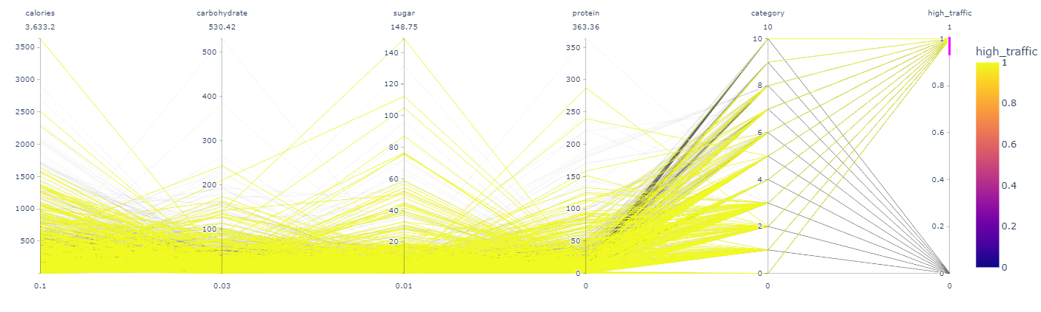
Parallel coordinates plot(PCP)

Slide 20
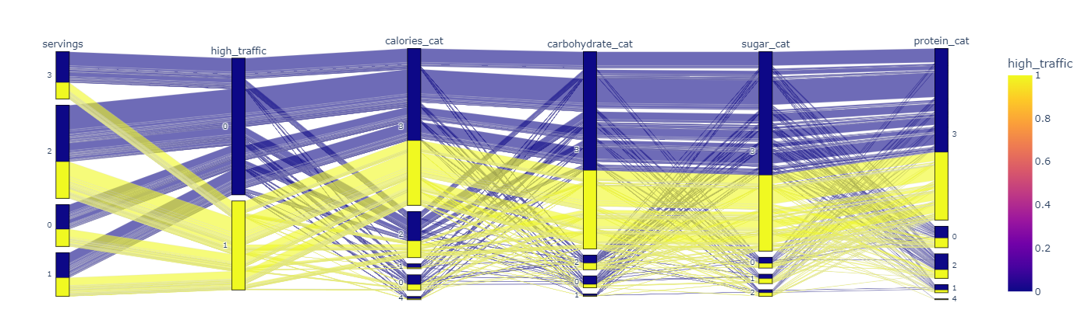
Parallel coordinates plot(PCP)

Slide 21
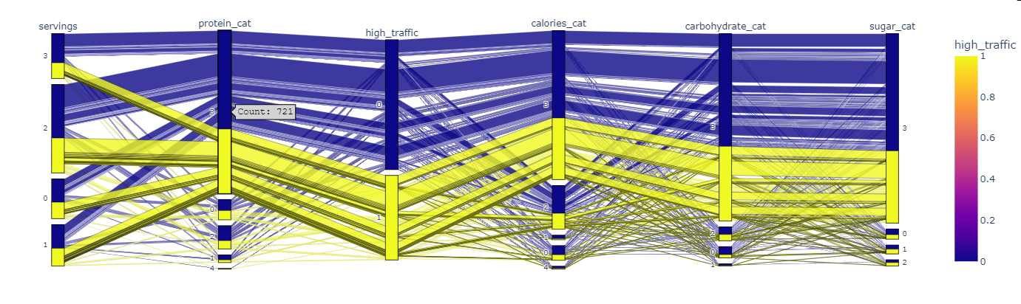
Parallel coordinates plot(PCP)
We can see how protein can affect the high traffic for example for protein category 3 ‘too-low’ affect highly in how the traffic increase

Slide 22
Models and Business metrics

Slide 23
Business metric
We care more for the prediction of the recipes that can achieve high traffic more than the over all accuracy
Which will be measured as number of predicted as Hight traffic recipes and was a high traffic one over the total number of all the high traffics recipes that our model predicted
Out of all high traffic recipes how many were correct
This metric is the Recall

Slide 24
Business metric
Out of all high traffic recipes how many were correct
This metric is the Recall
We need at least to reach 80% or higher to achieve the KPI and increase the traffic on the website

Slide 25
Models
Decision Tree
Logistic Regression
Random Forest
Extra Randomized Trees
Ada boost
Ensemble Learner
Gradient Boosting
66% Business metric
67% cross validation
64% test
99% train
Decision Tree enhanced
81% Business metric
76% Cross validation
76% test
76% train
83% Business metric
76% Cross Validation
75% test
76% train
84% Business metric
72% Cross Validation
72% test
99% train
Random Forest enhanced
83% Business metric
75% Cross Validation
74% test
85% train
71% Business metric
64% Cross validation
65% test
99% train
87% Business metric
72% Cross Validation
75% test
78% train
Ada boost enhanced
81% Business metric
76% Cross Validation
76% test
76% train
81% Business metric
76% Cross validation
73% test
80% train
84% Business metric
71% Cross validation
73% test
86% train
Gradient Boosting enhanced
81% Business metric
76% Cross validation
76% test
76% train

Slide 26
Models
Logistic Regression
Ada boost
Decision Tree enhanced
81% Business metric
76% Cross validation
76% test
76% train
83% Business metric
76% Cross Validation
75% test
76% train
Random Forest enhanced
83% Business metric
75% Cross Validation
74% test
85% train
87% Business metric
72% Cross Validation
75% test
78% train
Ada boost enhanced
81% Business metric
76% Cross Validation
76% test
76% train
Gradient Boosting enhanced
81% Business metric
76% Cross validation
76% test
76% train

Slide 27
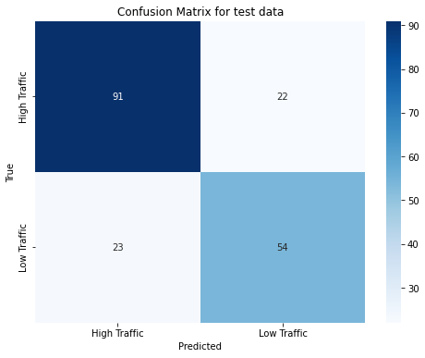
Models
Decision Tree enhanced
81% Business metric
76% Cross validation
76% test
76% train
Business metric 81%
Recall of class high
Recall of class low traffic 70%

Slide 28
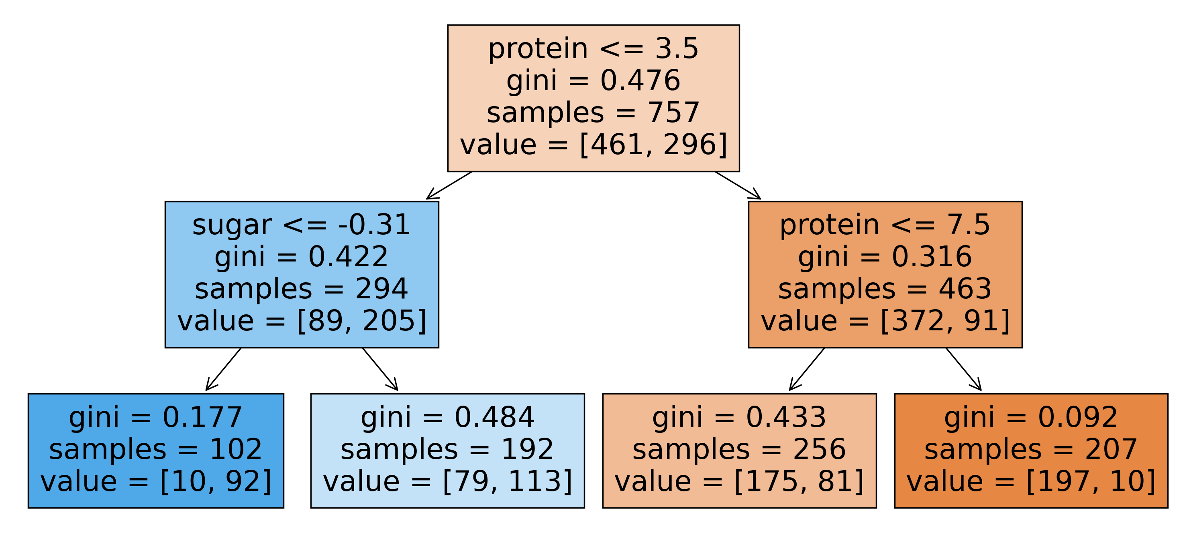
Models
Decision Tree enhanced
81% Business metric
76% Cross validation
76% test
76% train

Slide 29
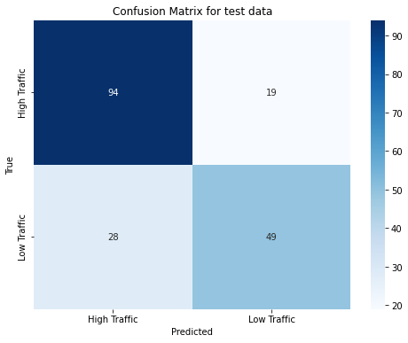
Models
Logistic Regression
83% Business metric
76% Cross Validation
75% test
76% train
Business metric 83%
Recall of class high
Recall of class low traffic 64%

Slide 30
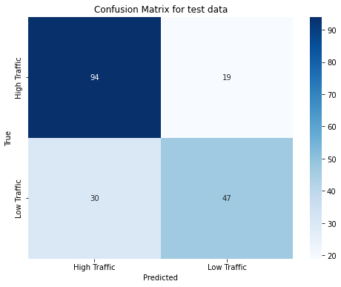
Models
Random Forest enhanced
83% Business metric
75% Cross Validation
74% test
85% train
Business metric 83%
Recall of class high
Recall of class low traffic 61%

Slide 31
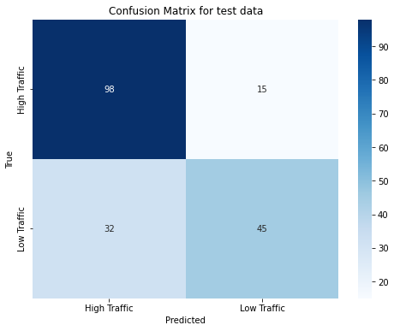
Models
Ada boost
87% Business metric
72% Cross Validation
75% test
78% train
Business metric 87%
Recall of class high
Recall of class low traffic 58%

Slide 32
Models
Ada boost enhanced
81% Business metric
76% Cross Validation
76% test
76% train
Business metric 81%
Recall of class high
Recall of class low traffic 70%

Slide 33
Models
Gradient Boosting enhanced
81% Business metric
76% Cross validation
76% test
76% train
Business metric 81%
Recall of class high
Recall of class low traffic 70%

Slide 34
Models Finals
Gradient Boosting enhanced/ Ada boost enhanced
81% Business metric
76% Cross validation
76% test
76% train
Decision Tree enhanced
81% Business metric
76% Cross validation
76% test
76% train
Recall
Hight:81%
Low: 70%
Recall
Hight:81%
Low: 70%

Slide 35
What model satisfy the KPI

Slide 36
Decision Tree enhanced
81% Business metric
76% Cross validation
76% test
76% train
Easy to interpret how the decision is made
Recall
Hight:81%
Low: 70%

Slide 37
Feature importance

Slide 38
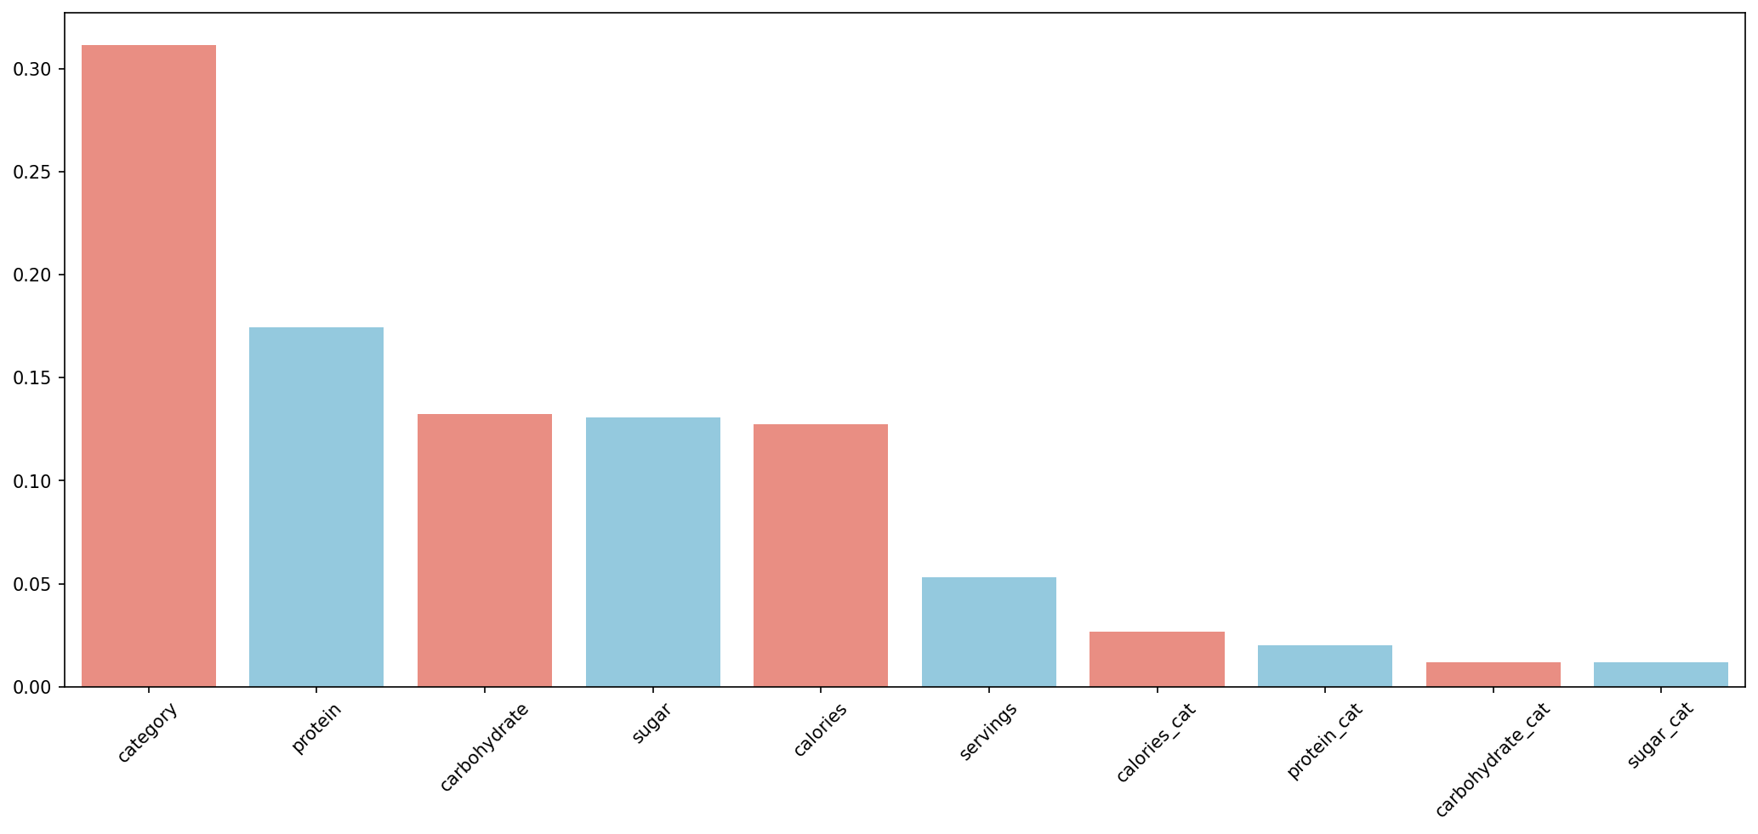

Slide 39
Recommendations

Slide 40
We need to personalize the user experience ; Tasty Bytes aim is to lead the world and provide inspiration in the field of food recipes and delivery.
But people taste defer and we need to make sure that every user experience is enjoyable and customized for that user.
That will make the user engaged more and even he will recommend this experience to his friends .
That will help in increasing the traffic and the time people spending in the website this is so important factor.
What I recommend ?
Building a Recommendation system in your website which will make each user experience a unique experience of what he really want to see.
Additionally, I suggest focusing on the features that greatly influence people's preferences. As we discussed earlier, some categories are more popular than others.

Slide 41




Thank you
Hossam Ahmed Salah
https://www.linkedin.com/in/hossamahmedsalah/

